Slide 1
Overview & State of Linkerd
KubeCon EU 2022

Slide 2

Matei David
Linkerd maintainer, Buoyant
@__mateidavid
@mateiidavid
@Matei David (Buoyant)
Your photo

Slide 3





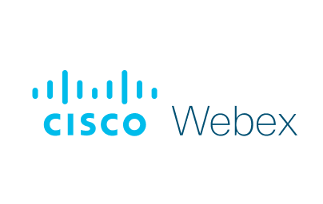






















A different kind of service mesh.
Ultralight, ultrafast, ultra-simple service mesh for Kubernetes.
4+ years in production
5,000+ Slack channel members
10,000+ GitHub stars
200+ contributors
Committed to open governance
Proposed for CNCF graduation
And many more...

Slide 4
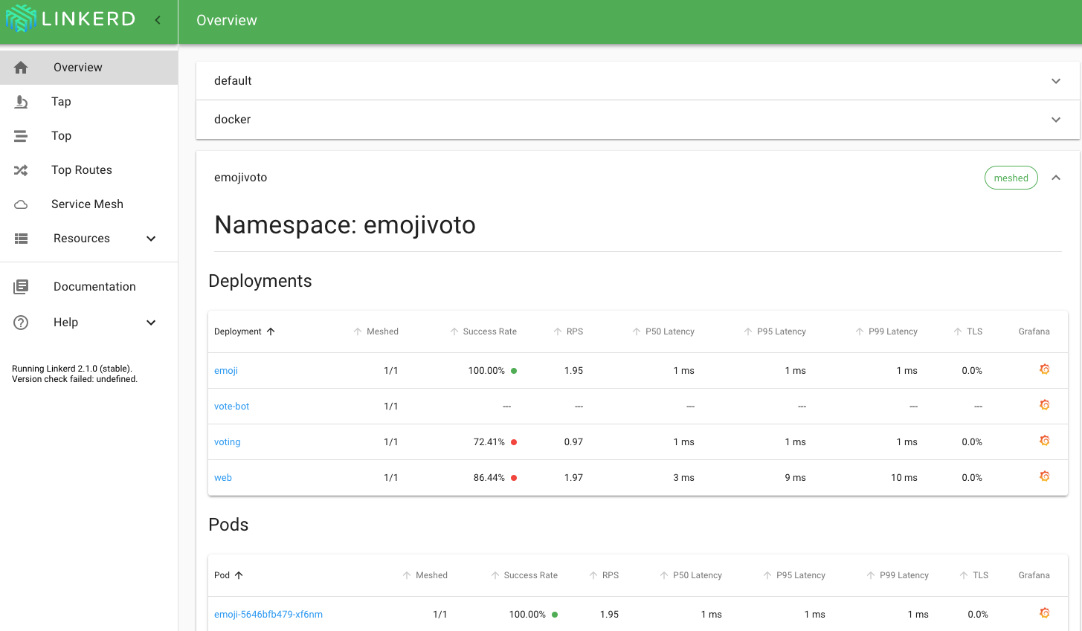
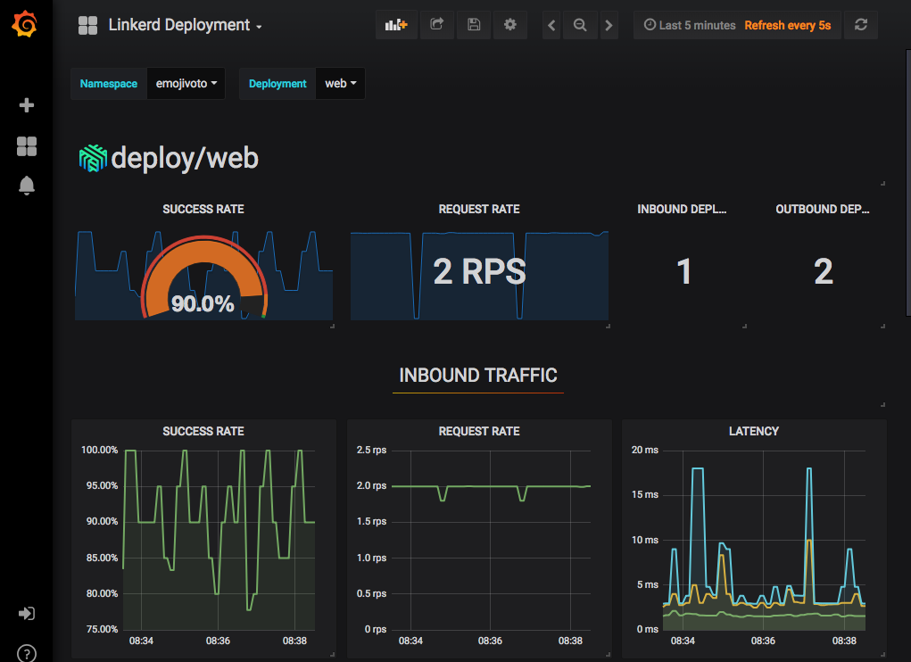
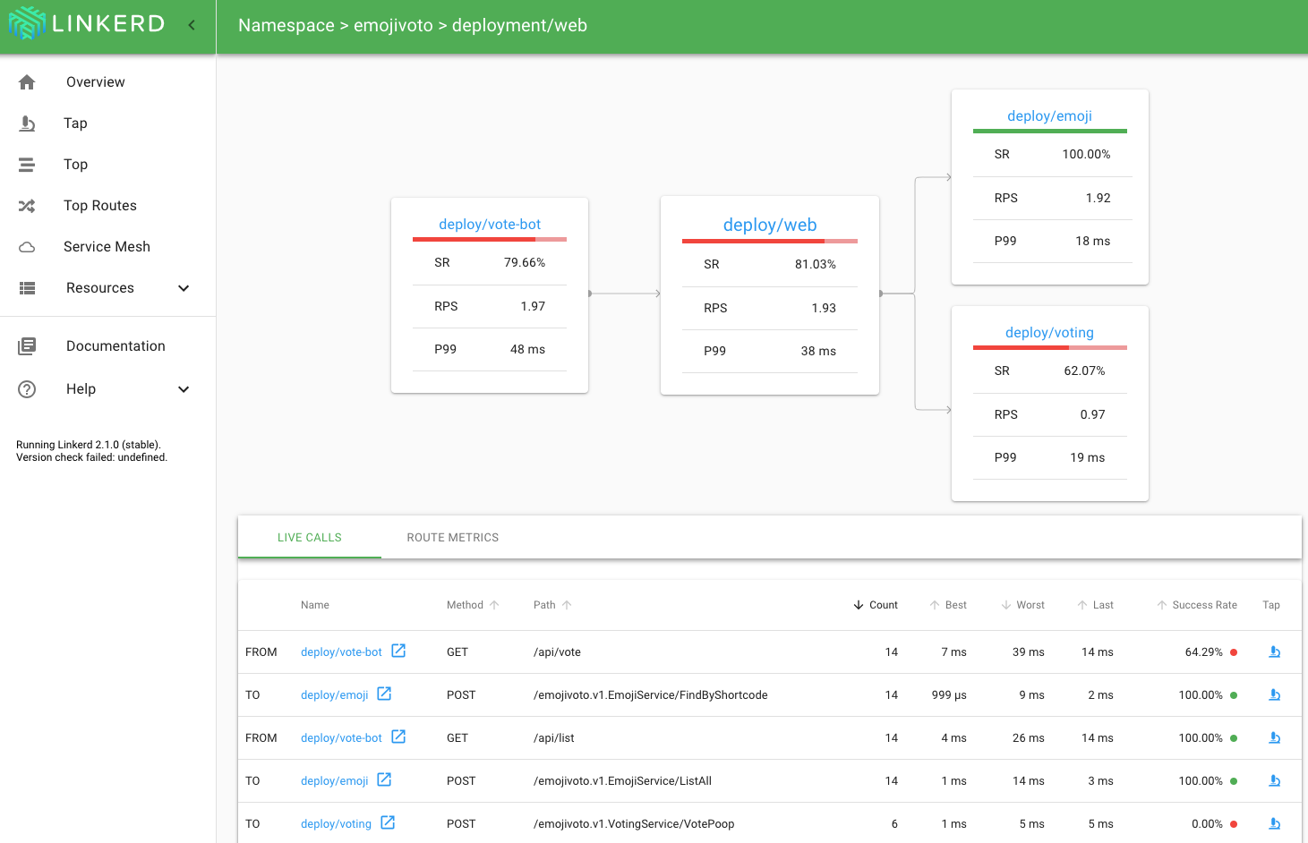
What does Linkerd do?
Observability: Service-level golden metrics: success rates, latencies, throughput. Service topologies.
Reliability: Retries, timeouts, load balancing, traffic shifting
Security: Transparent mTLS, cert management and rotation, policy*
In an ultralight package focused on operational simplicity first and foremost.

Slide 5
How is Linkerd designed?
"Less is more, and more is less."
Just works: Zero config, out of the box, for any Kubernetes app
Ultralight: Introduce the bare minimum perf and resource cost
Simple: Reduce operational complexity in every possible way
Security out of the box: make security the default, not the extra add-on.
Control plane: Go. ~200mb footprint. (github.com/linkerd/linkerd2).
Data plane: Rust. <20mb footprint, <1ms p99 (github.com/linkerd/linkerd2-proxy)
Background reading: Linkerd v2: How Lessons from Production Adoption Resulted in a Rewrite of the Service Mesh (InfoQ)
Notes:
Rust, Go, size of proxies, etc

Slide 6
What does Linkerd use for its data plane?
A "micro-proxy" called simply Linkerd2-proxy. (Not Envoy!)
Security first: Rust lets us avoid an entire class of memory vulnerabilities.
Ultralight, ultrafast: Rust compiles to native code. No runtime env/GC!
State-of-the art network stack: Built on Tokio, Hyper, H2, Tower, and the rest of the modern Rust async networking stack.
Philosophy: proxy should be an implementation detail. You should not have to become an operational expert in the proxy just to operate the service mesh! (See Why Linkerd Doesn't Use Envoy for more.)
Notes:
Rust, Go, size of proxies, etc

Slide 7
What is Linkerd's approach to security?
Linkerd is very security-focused and follows a strict philosophy:
Secure the foundations. E.g. Rust for Linkerd2-proxy.
Build on top of Kubernetes. E.g. ServiceAccounts for pod identity.
Remove the barriers. E.g. mTLS is on by default.
Complexity is the enemy of security. Reduce configuration, turn it all on by default, and don't make users have to work for security.

Slide 8
Linkerd vs Istio
A common question! It comes down to: what do you need in a service mesh?
Istio
Theme: Every feature, ever situation, no matter the complexity.
Pros:
Has all the features
Your boss has read a blog post about it
No one ever got fired for choosing IBM
Supports complex use cases
Cons:
Big, complex, hard to operate
Linkerd
Theme: the bare minimum to build a secure, reliable, flexible Kubernetes platform.
Pros:
Much easier to understand and operate
Smaller, lighter, faster
Secure by default
Kubernetes native
Cons:
Only works on Kubernetes

Slide 9
Linkerd’s Year in Review

Slide 10
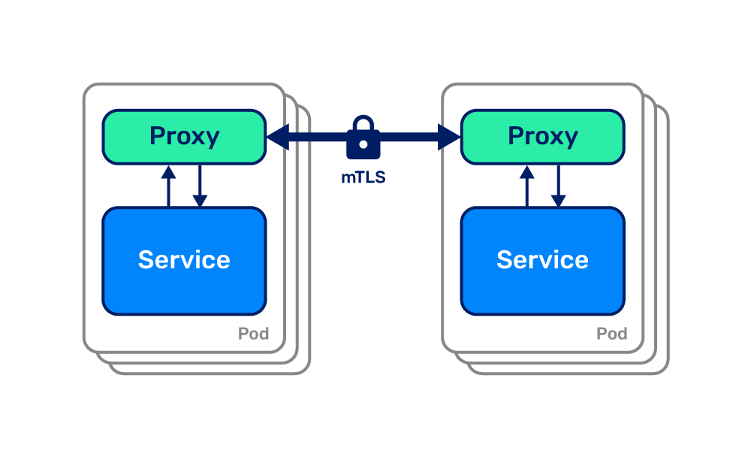
Linkerd 2.9: mTLS for all
Extends zero-config mutual TLS support to TCP connections, allowing all traffic to be transparently encrypted and authenticated.
ARM support allows Linkerd to run anywhere
Multi-core proxy runtime adds throughput and concurrency
Service topologies introduce routing preferences on a per-node basis
Bring your own Prometheus making the control plane lighter

Slide 11
Linkerd 2.10: Modularized control plane with extensions
Extensions make the control plane modularized: install just the components that you want.
Default control plane: just the bare minimum for operation (200mb)
viz extension: metrics stack (Prometheus, Grafana, dashboard)
jaeger extension: distributed tracing
multi-cluster extension: multi-cluster machinery
Extensions can also come from third parties, and fit seamlessly into linkerd install, linkerd check, etc.
In addition to extensions, 2.10 includes opaque ports to proxy without protocol detection, extends multi-cluster to all TCP connections, and lots more.

Slide 12
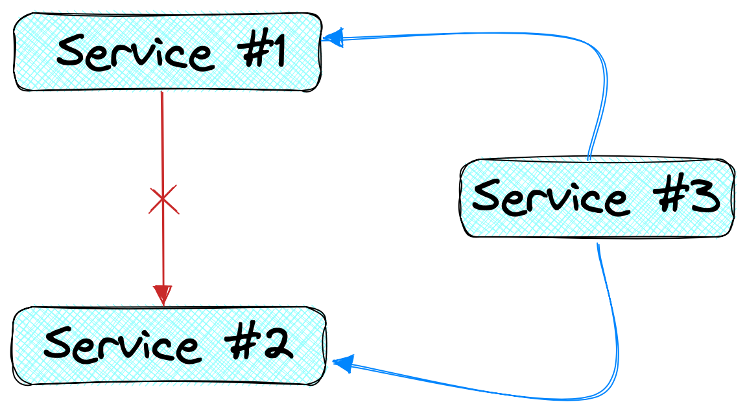
Linkerd 2.11: Policy, gRPC retries, and more!
Authz:
Fine-grained access control
Expressed in a composable, Kubernetes-native way
Works with Linkerd’s secure service identities and network ranges
gRPC Retries: HTTP requests with bodies, with a max payload of 64KB can be retried
Perf: proxy footprint even smaller, control plane down to 3 deployments
…and many more features, multicluster headless support, fuzz testing, CLI tab completion, etc.

Slide 13
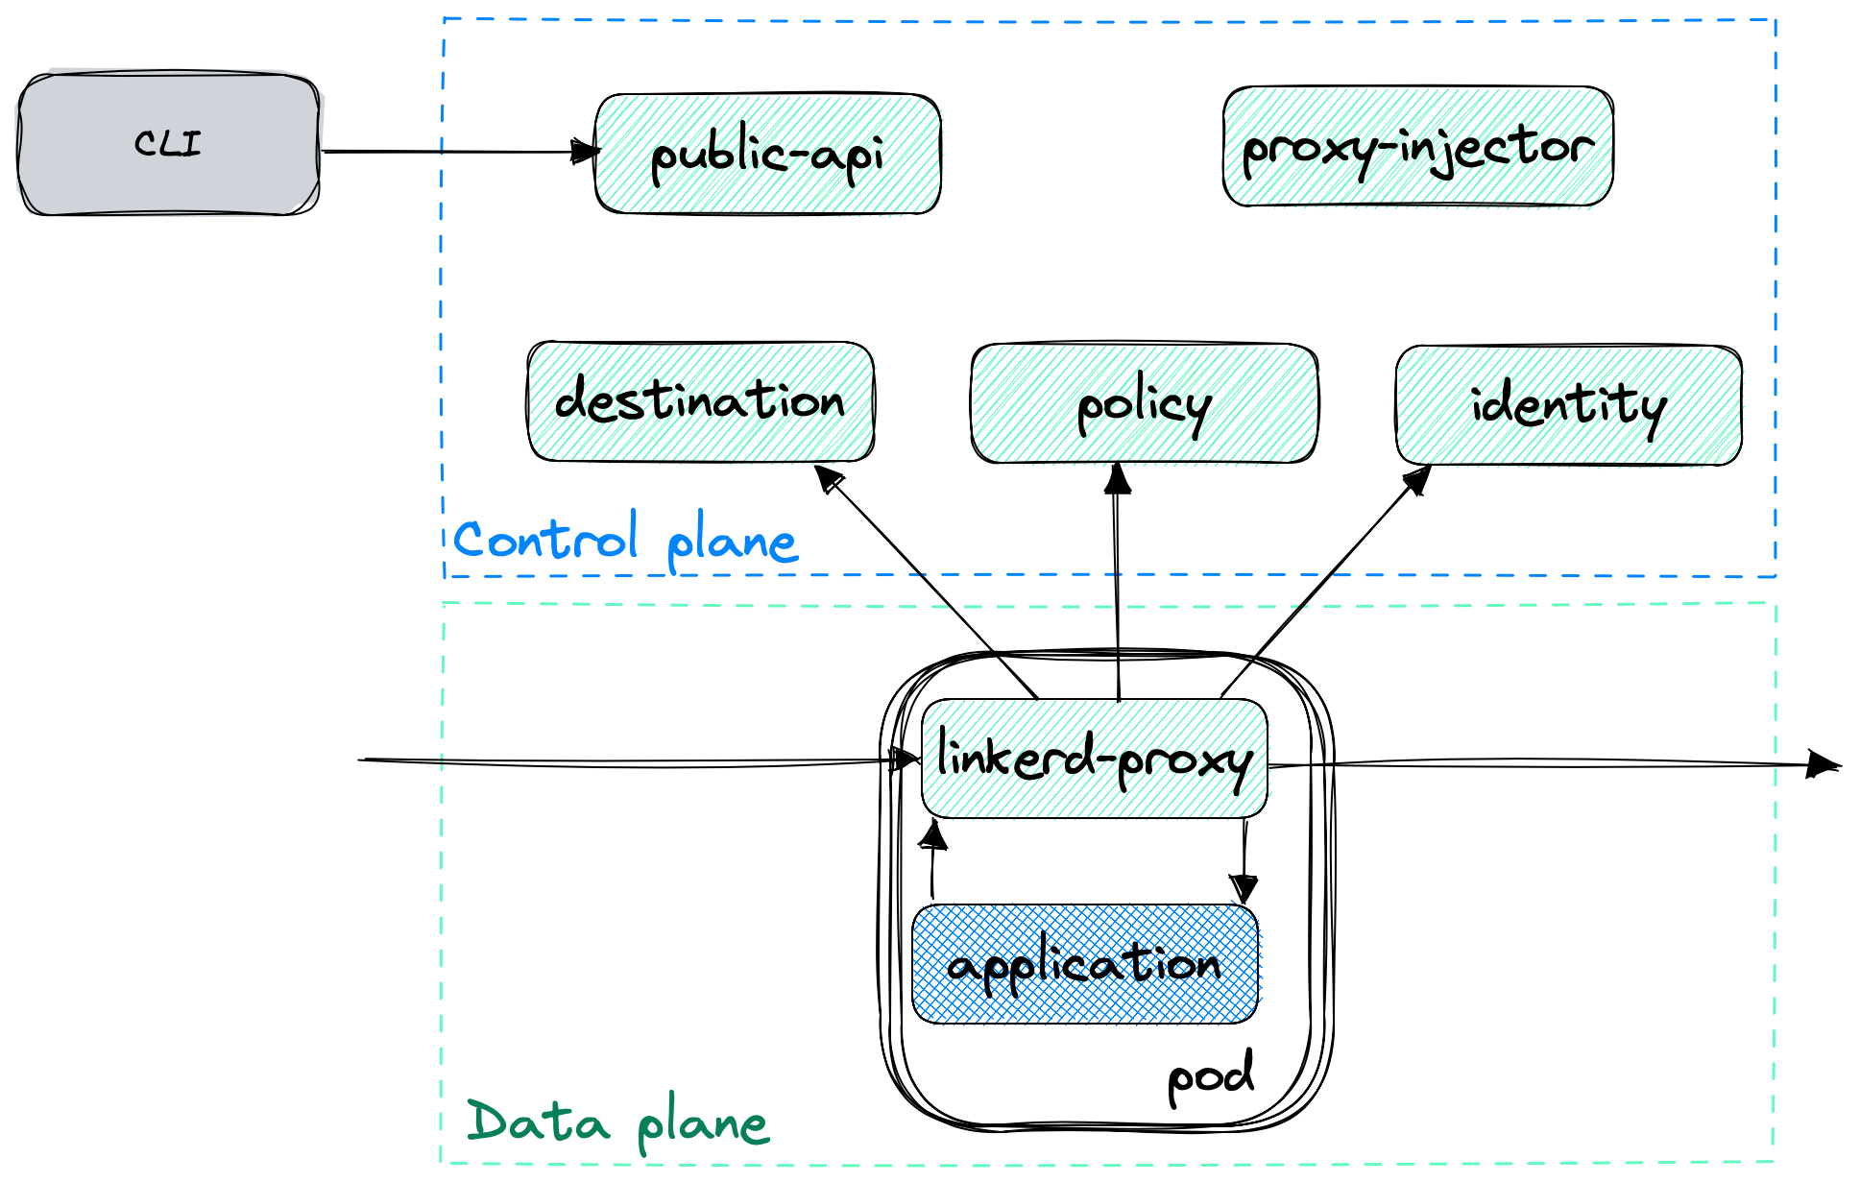
Linkerd 2.11 architecture

Slide 14
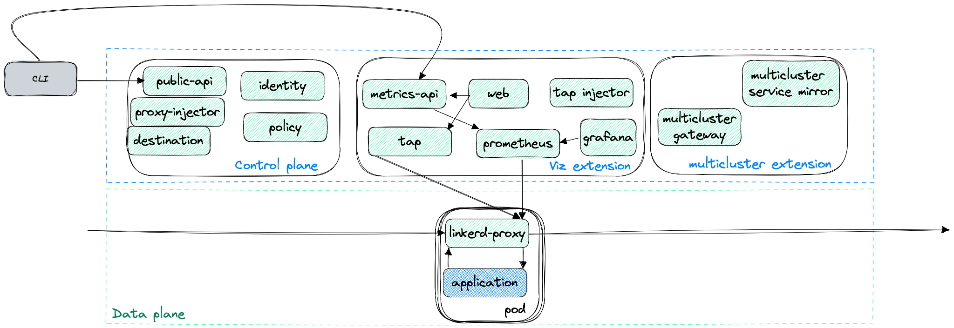
Linkerd 2.11 with extensions

Slide 15
What’s next for Linkerd
In 2021, Linkerd achieved graduated status in the CNCF, and introduced authorization policies and an extension model!
More exciting work is planned for 2.12 and beyond:
🚀 Client policies: header-based routing, circuit breaking, egress control, etc.
🚀 Server policies: extend server authorization to cover gRPC and HTTP verbs and routes 🚀 CNI: better integration and tooling to run Linkerd with other CNI plugins 🚀 Integrations: SPIFFE support and mesh expansion

Slide 16
Linkerd talks at this conference!
May 17
Protocol Detection: A Deep Dive into How Linkerd Achieves Zero-Config (ServiceMeshCon)
Locating and Debugging Failures with Linkerd and Telepresence (Lightning talk)
May 18
Multi-cluster Failover Using Linkerd
Autoscaling Kubernetes Deployments: A (Mostly) Practical Guide
May 19
Emissary + Linkerd: A Guide to End-to-End Encryption for your Cluster
Service Mesh at Scale: How Xbox Cloud Gaming Secures 22k Pods with Linkerd
May 20
How Linkerd Helped bink Partner up with Barclays
Linkerd End User Panel: Case Studies from Production
Building an Agile Platform in a Highly Regulated Industry

Slide 17
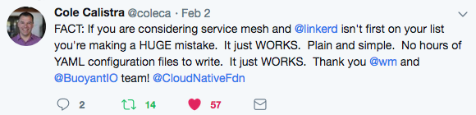
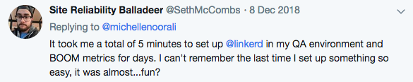
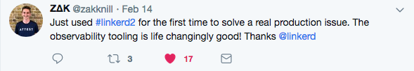

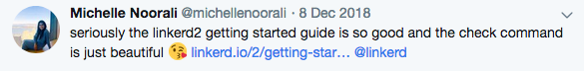
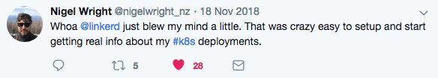
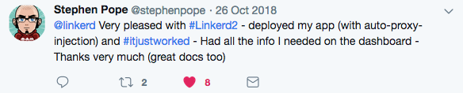
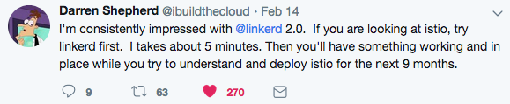
Get involved!
Development is all on GitHub
Thriving community in the Slack
Formal announcements on the CNCF mailing lists
Formal 3rd-party security audits
Linkerd has a friendly, welcoming community! Join us!
Linkerd is 100% Apache v2 licensed, owned by a neutral foundation (CNCF), and is committed to open governance.

Slide 18

We are hiring!
Sr. Software Engineer, Linkerd
Sr. Software Engineer, Linkerd Proxy (Rust)
Engineer Manager
Project Manager, Linkerd
Developer Advocate
​Developer Education Engineer
👉 Learn more at buoyant.io/jobs

Slide 19
Thank you
Matei David
Linkerd Maintainer, Buoyant
matei@buoyant.io

